Slide 1
HEALTH & ROUTINE MANAGEMENT SYSTEM
ANKUSH DEORA MOOLCHAND 001822054
KRISH PRAVIN JAIN 001881885
NEHA HASMUKH JAIN 001237437

Slide 2
INTRODUCTION
In the fast pace life, individuals regularly neglect to track or maintain a balance in their routine life. The objective of this project is to empower a man to keep a beware of his work-health-daily schedule. Our smart application will give a drastically extraordinary approach in following of wellbeing, getting sorted out individual's every day work plan, monitoring his other day by day routine and in this manner giving valuable proposals to the individual. The recommendations and activities will be an after effect of the examination performed on information got from number of such individuals in the ecosystem.

Slide 3
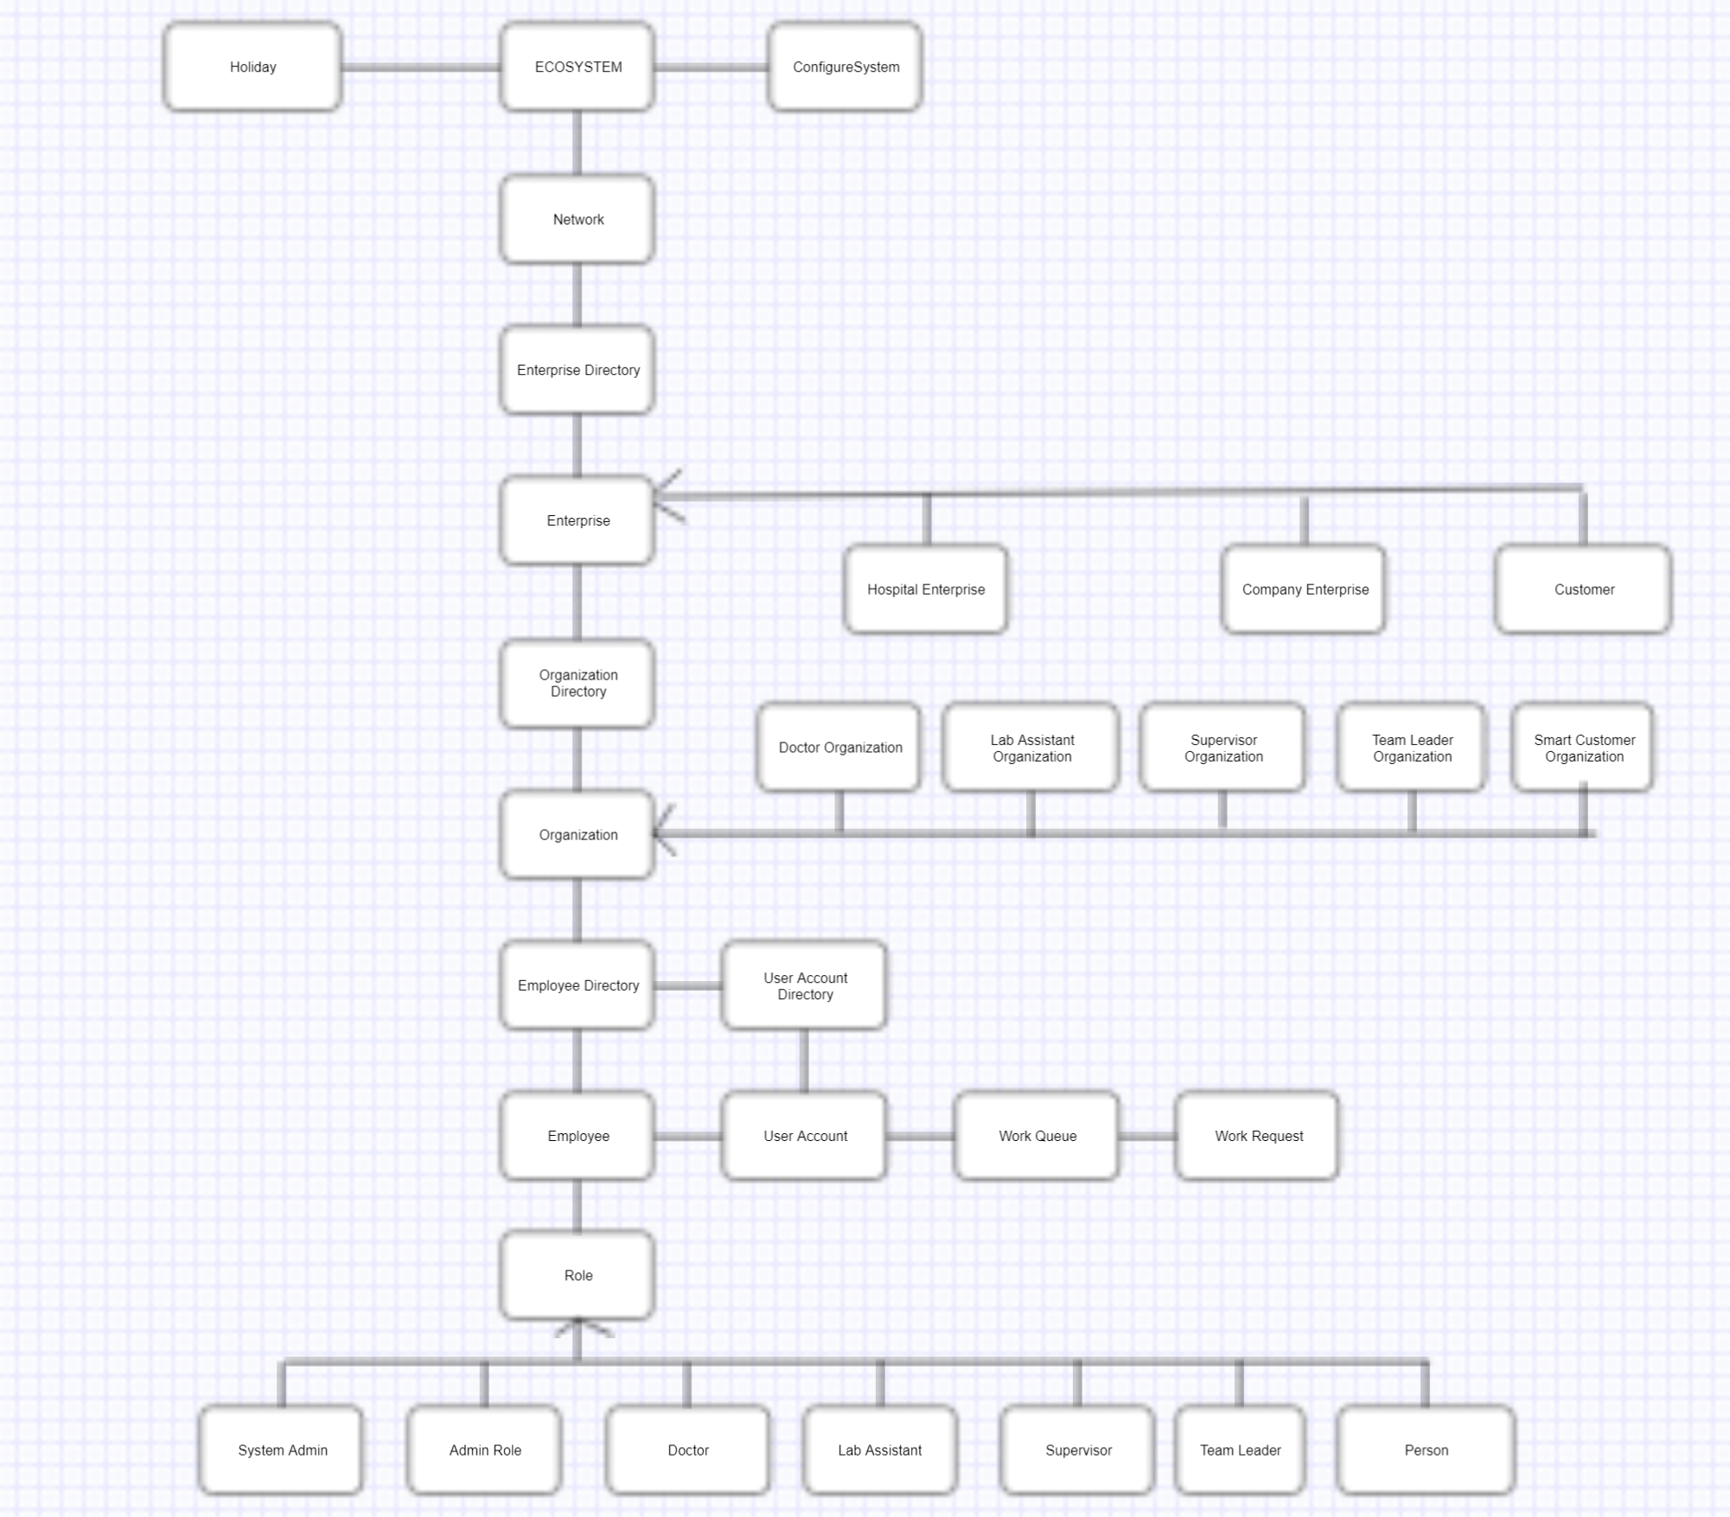
OBJECT MODEL

Slide 4
ACTORS
System Admin
Enterprise Admin
Doctor
Lab Assistant
Supervisor
Team Leader
Person

Slide 5
USE CASES
Health Domain:
Capture vital signs of the person
Automatic Trigger to the doctor about the person’s abnormal vital sign
Set up an appointment with the doctor
Generation of the Health Report
Doctor can send precautions to the patient under non-critical situations

Slide 6
USE CASES
Routine Domain:
Capture sleeping trend of the person
Capture the total calories in take during food consumption
Capture the person’s work-out trend
Allow the person to view and compare his routine with the world community
Recommendation :
Recommend person about how much more or less his/her sleeping trend is comparing the world’s sleeping trend
Recommend person about how much calories he/she must intake or how much work-out should be done to burn calories in order to maintain optimum BMI
Alert when the person has burnt the targeted calories for the day

Slide 7
USE CASES
Work Place Domain:
Request for leaves
Monitor person’s Work Schedule and give alerts based upon set thresholds
View Schedule trends, progress reports and leave trends
Recommendation:
Recommend the person the best suitable vacation time to maximize his leave duration without exciding his leave balance threshold
Sending Alert to the person if he/she works or break at a stretch beyond the threshold specified
Recommending the person about his work schedule after analyzing his previous week work schedule

Slide 8
USE CASES
Automatic Trigger of Person’s Abnormal Vital Sign to the Doctor during capturing his vital sign
Automatic Trigger of Person’s Abnormal Vital Sign to the Doctor if any abnormal vital sign is observed during work-out
Allowing the Person to view contact details of various Doctor’s and Fitness area in the world in case if his travelling and is in emergency via Web Technology .
Sending e-mails to the person about his appointments and leave approval status

Slide 9
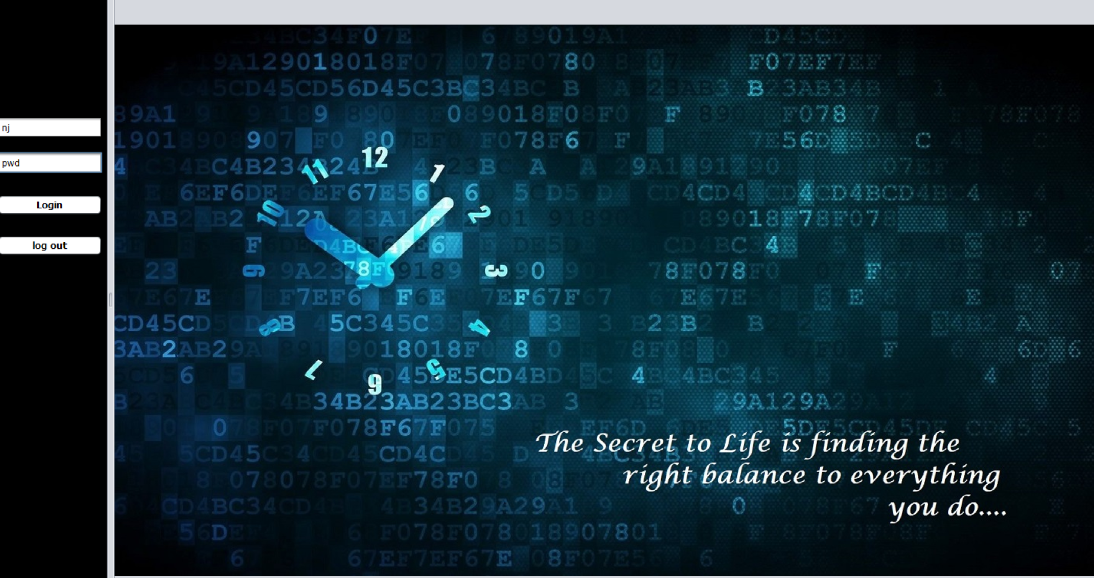
SCREENSHOTS

Slide 10
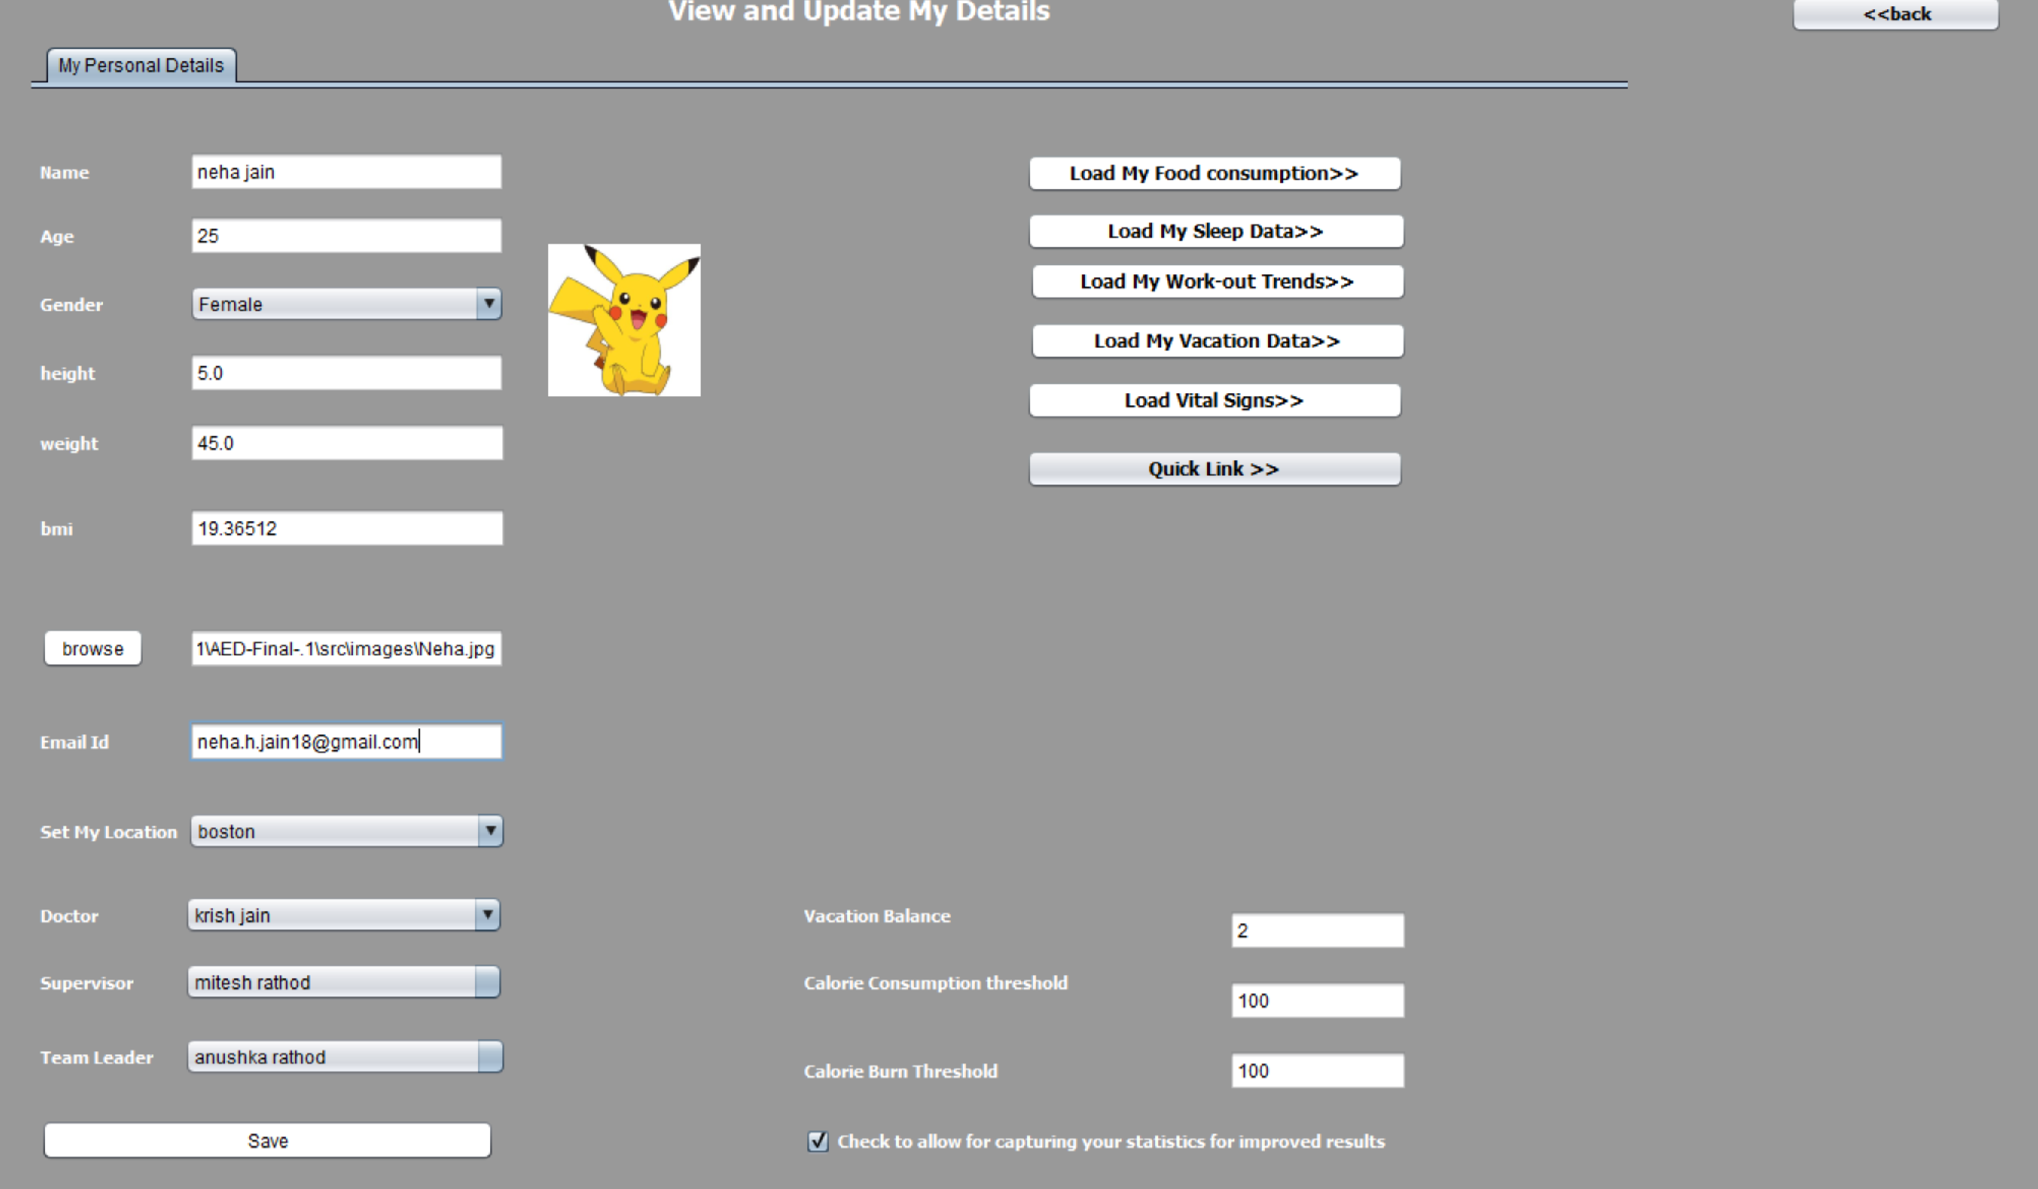

Slide 11
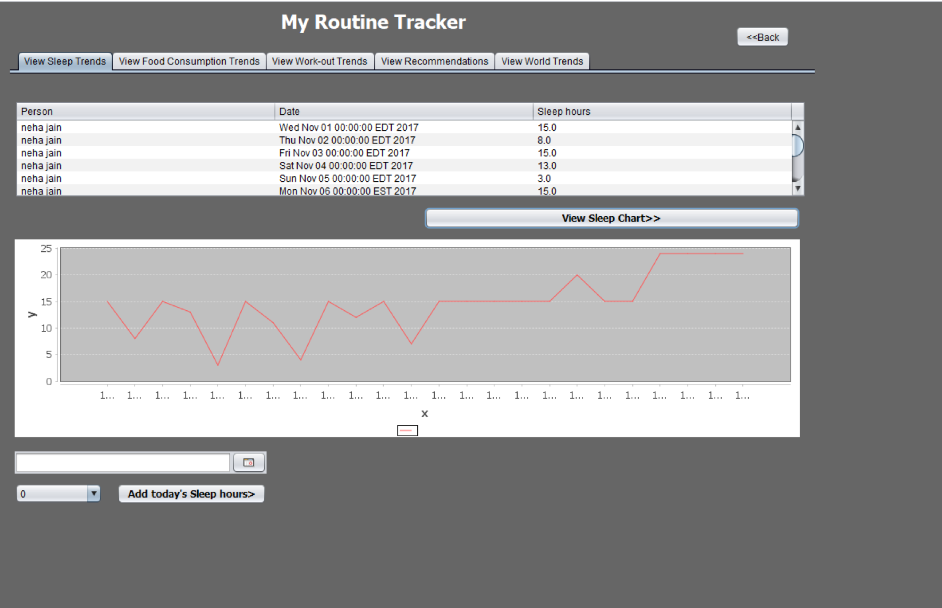

Slide 12
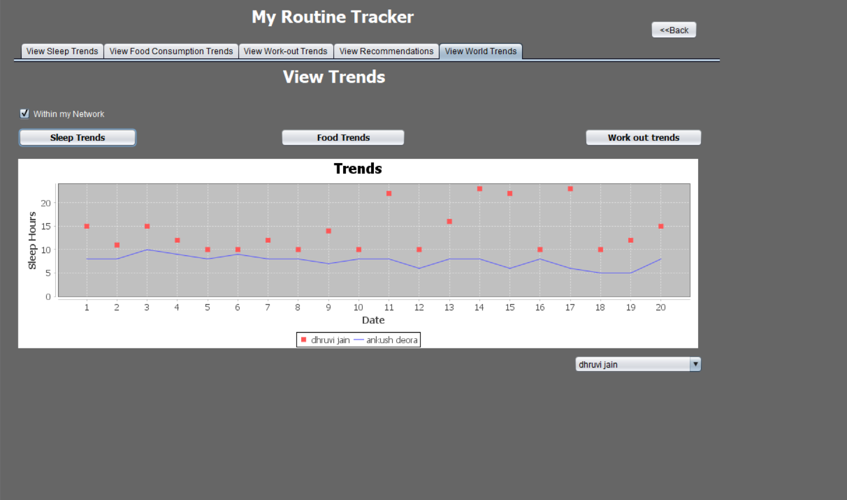

Slide 13
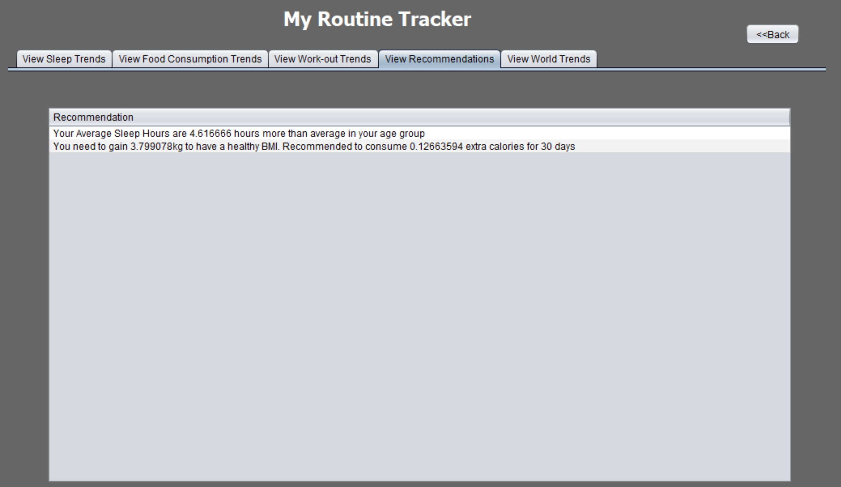

Slide 14
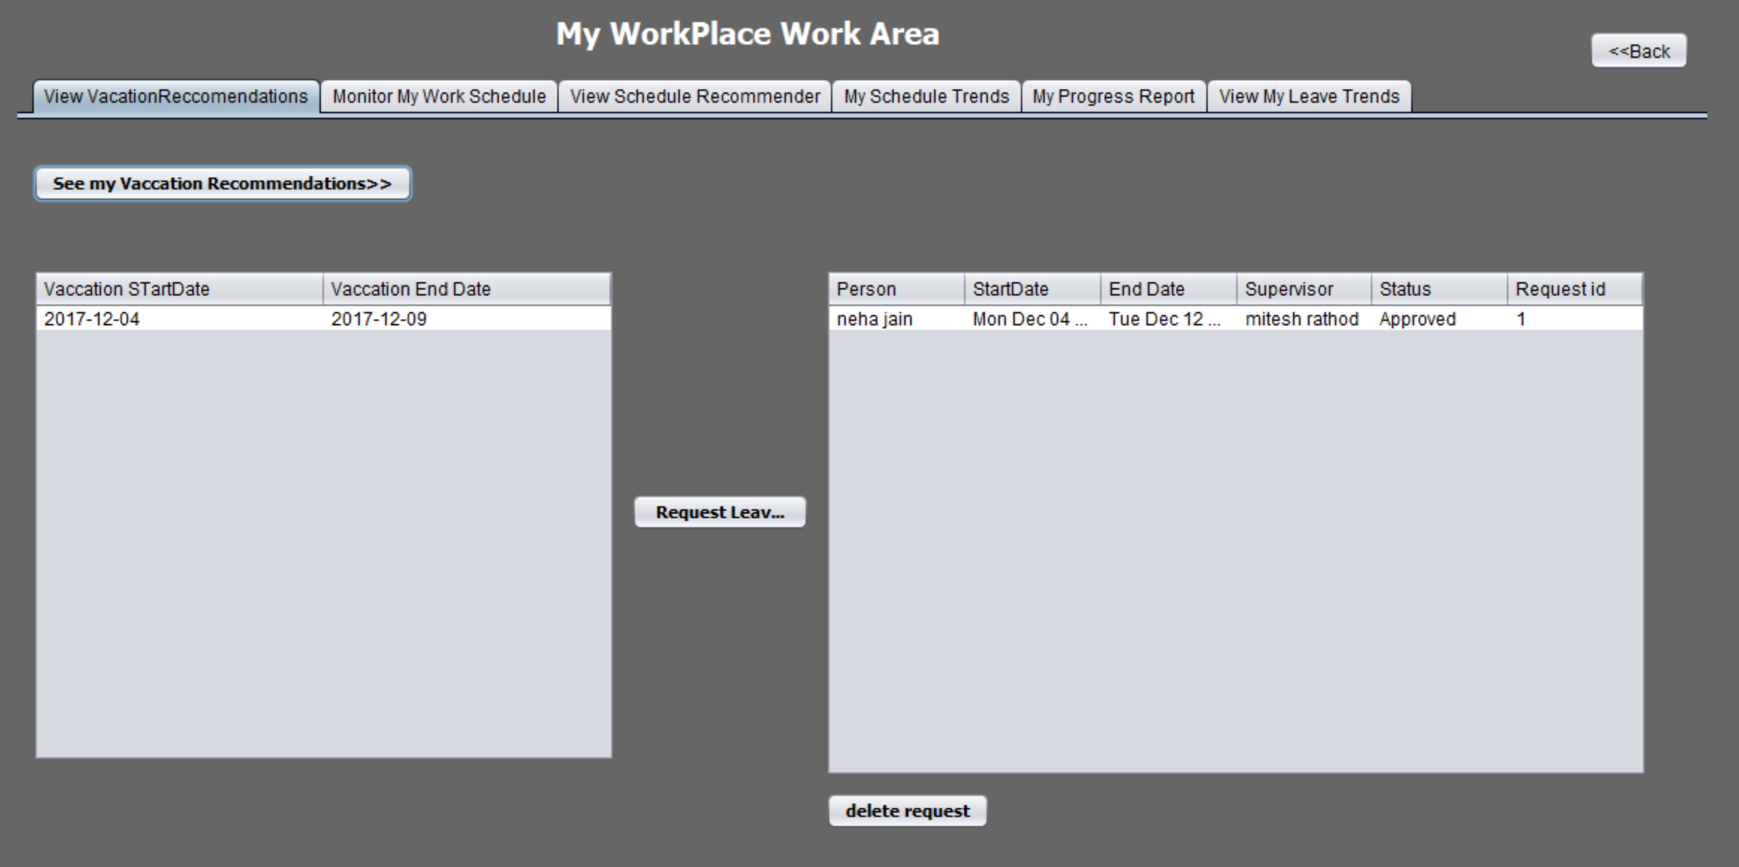

Slide 15
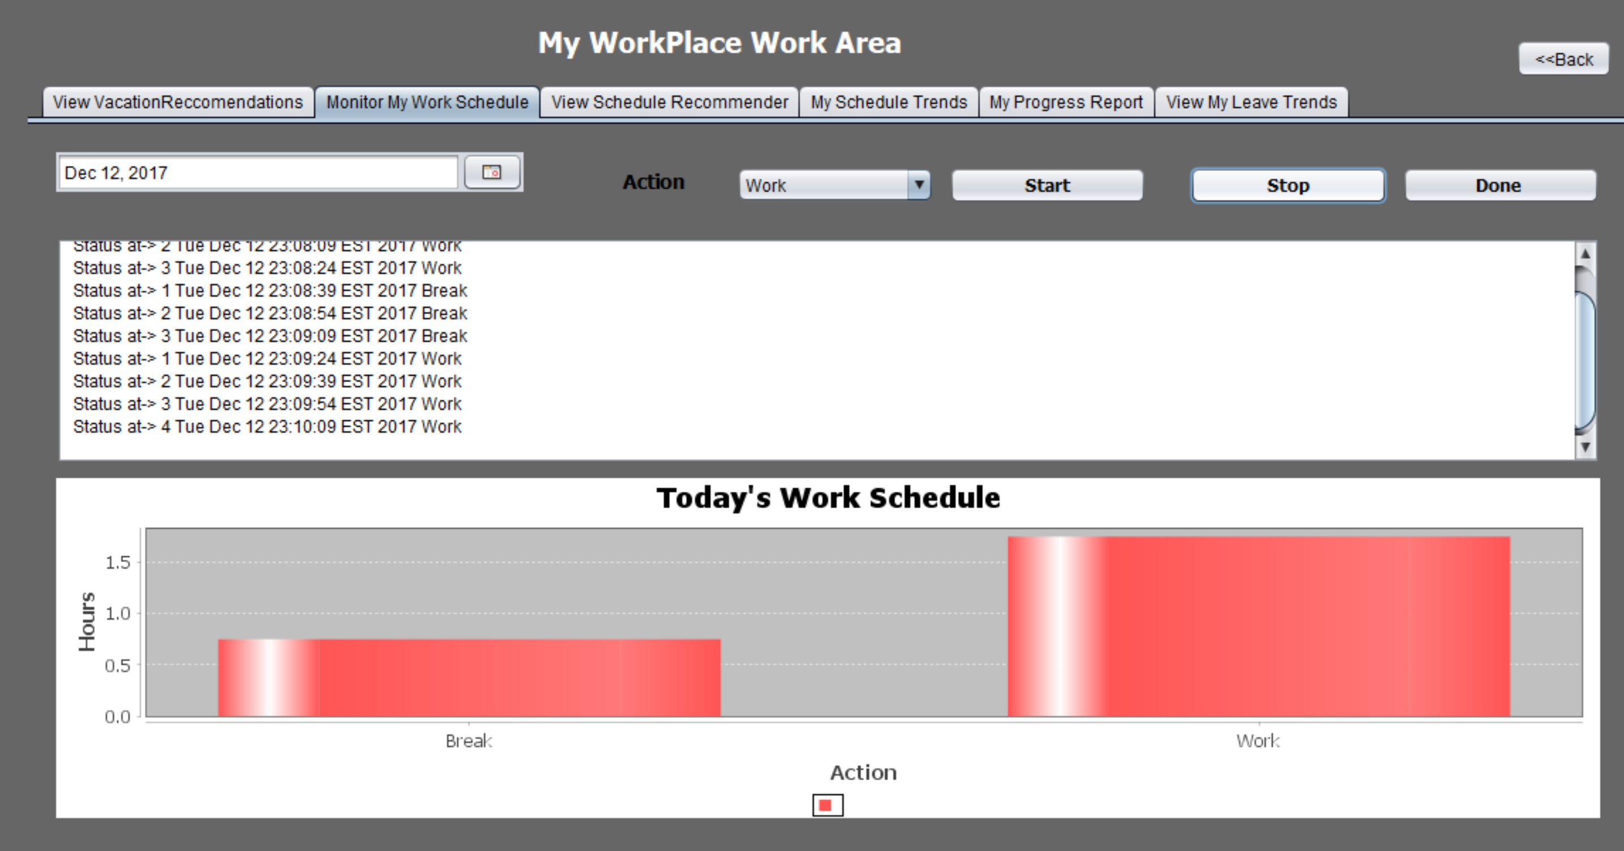

Slide 16
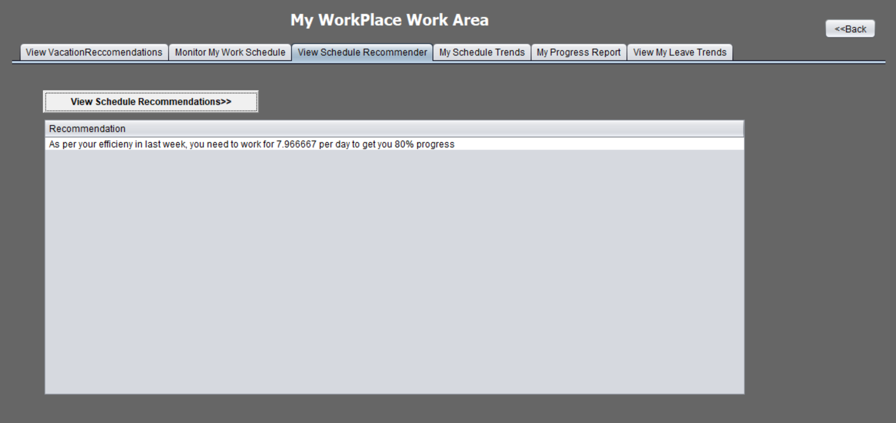

Slide 17
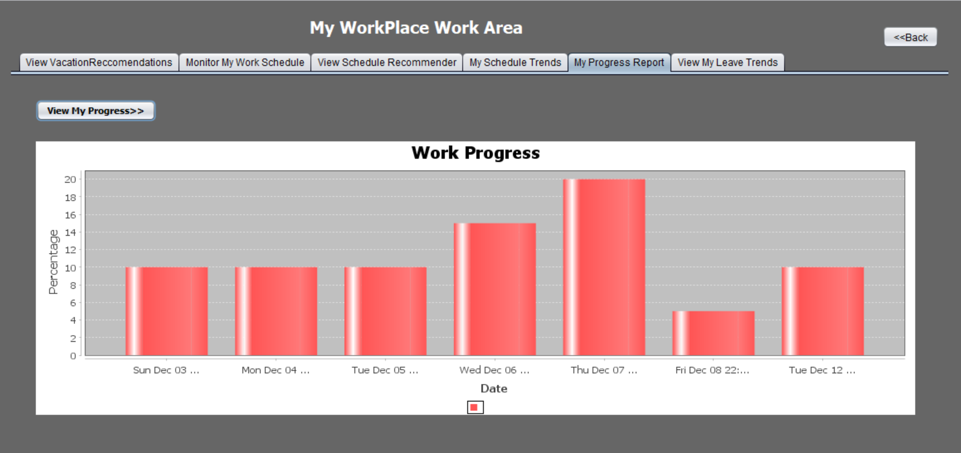

Slide 18
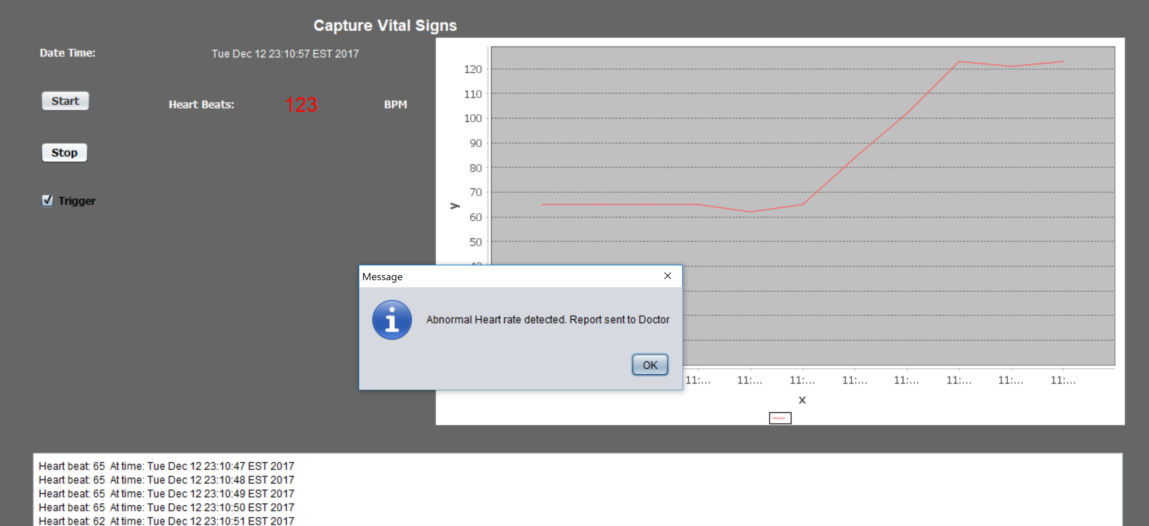

Slide 19
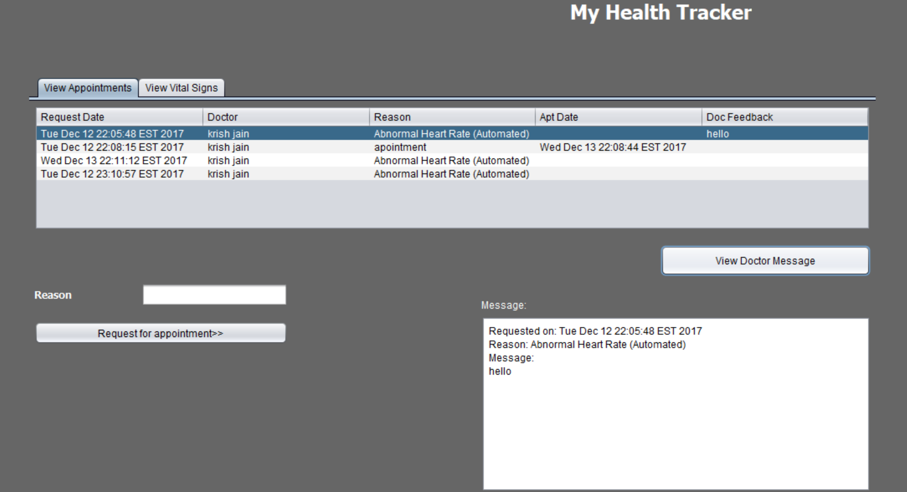

Slide 20
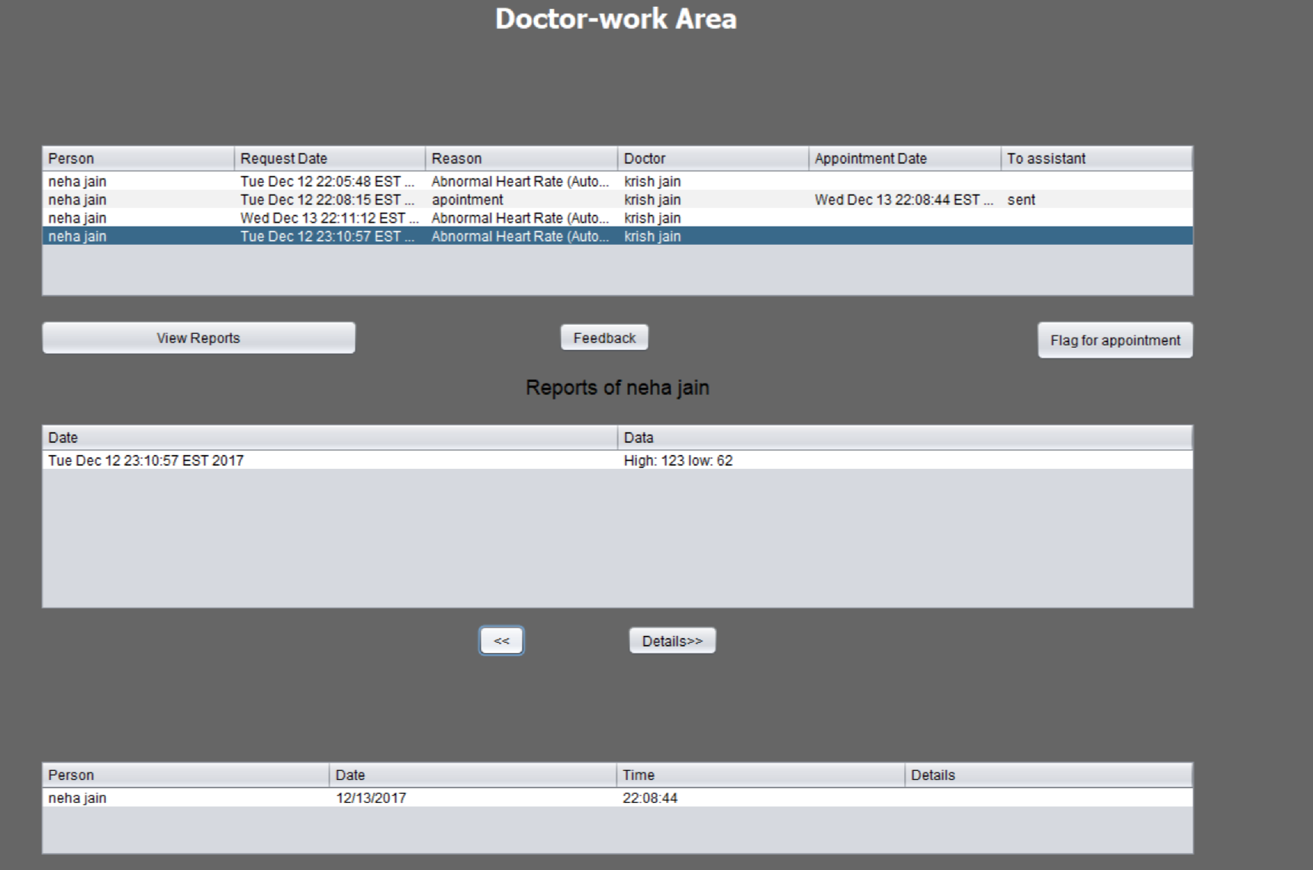

Slide 21
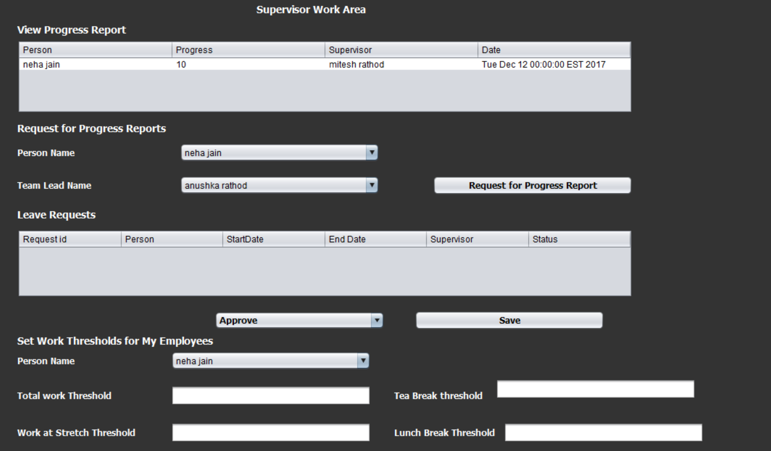

Slide 22
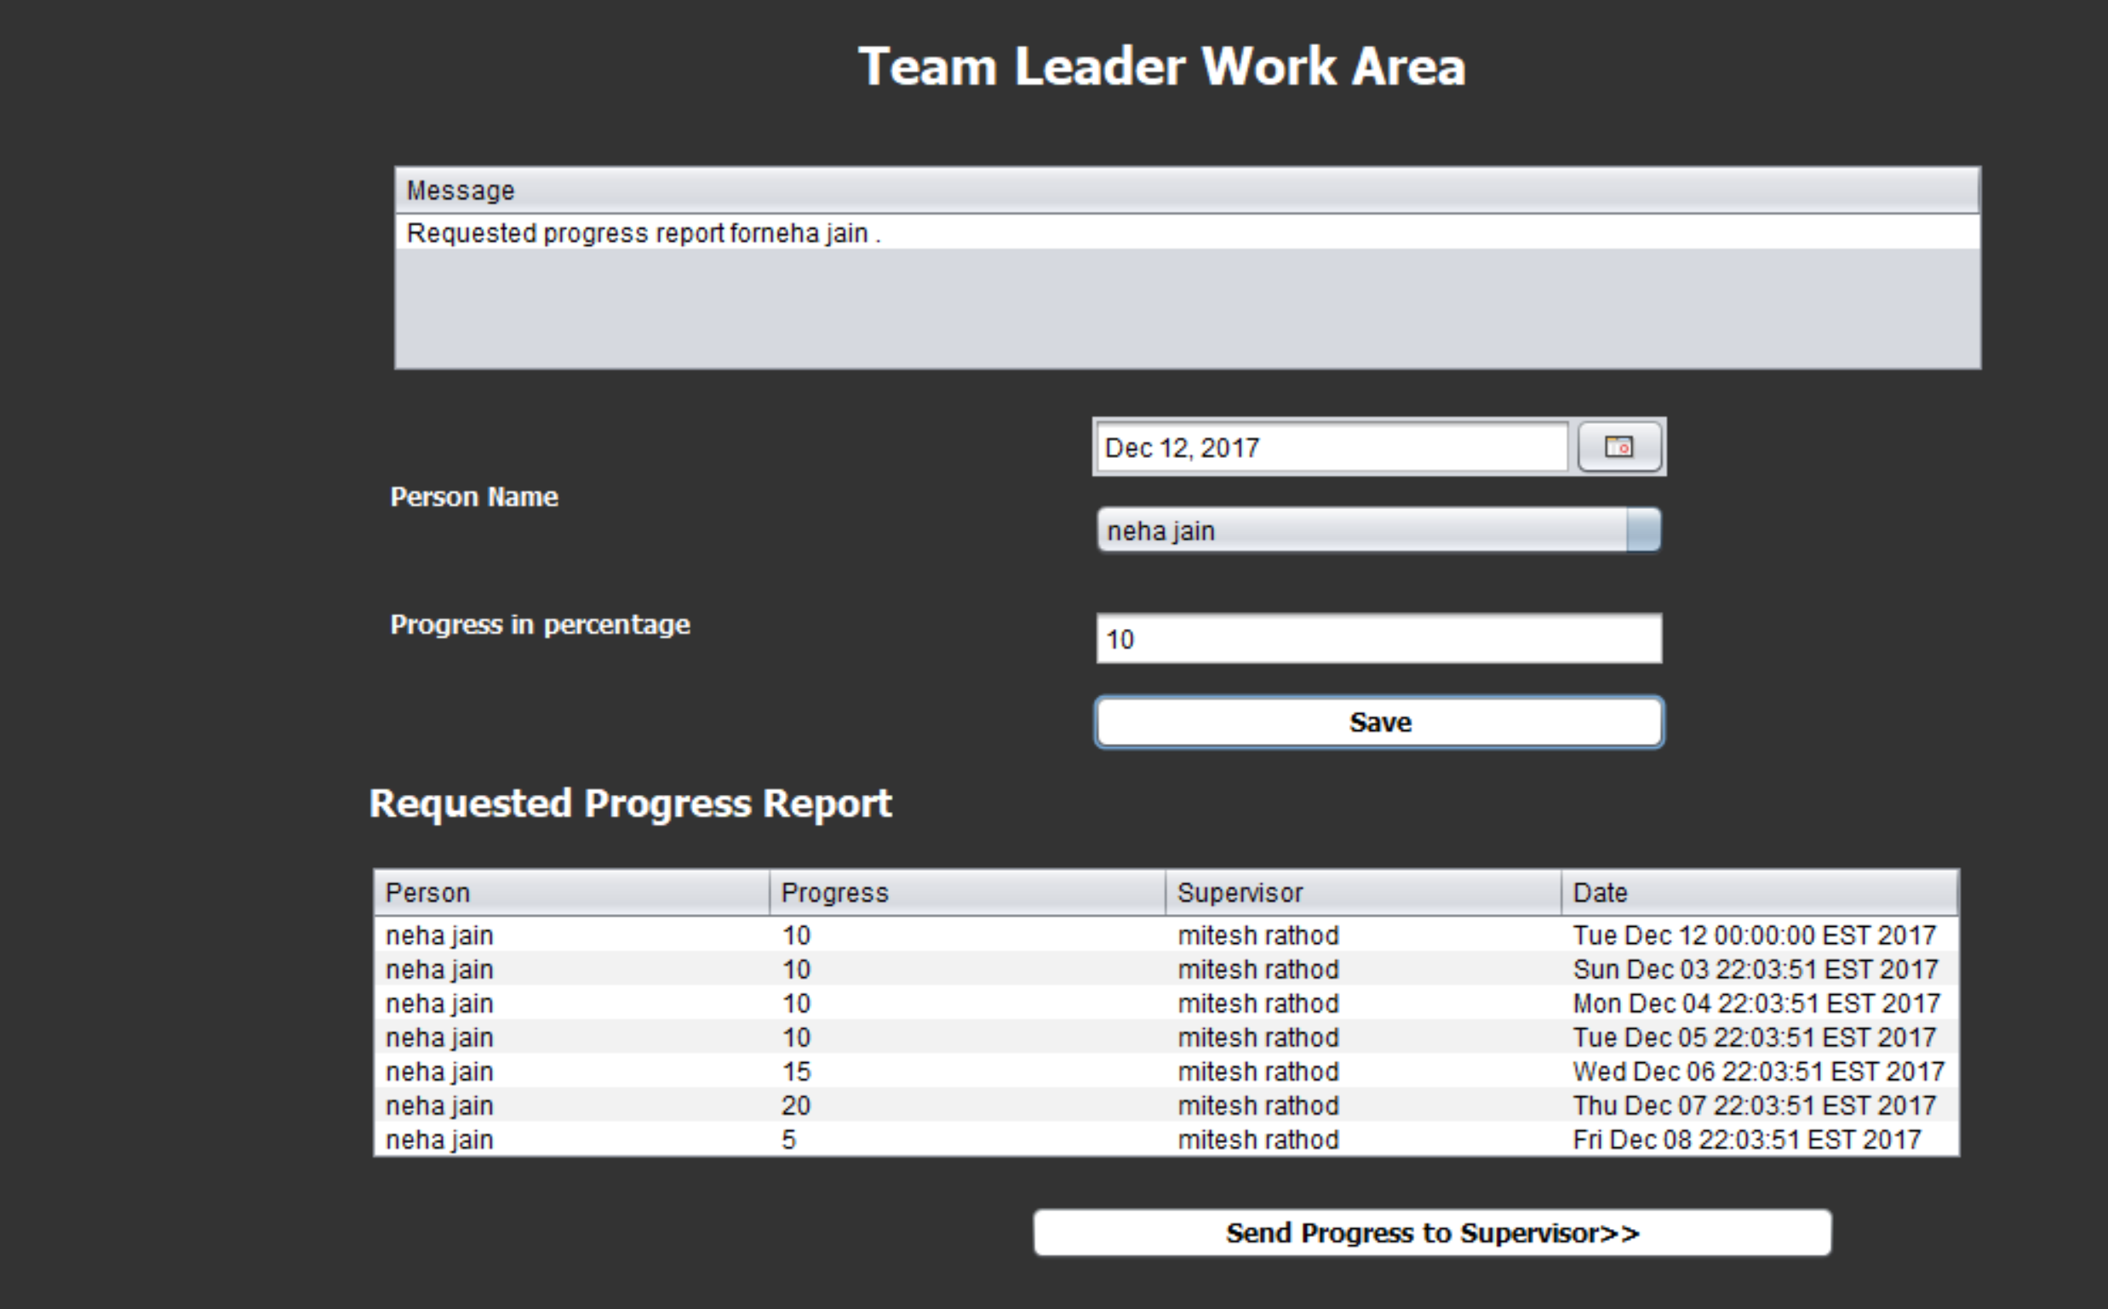

Slide 23
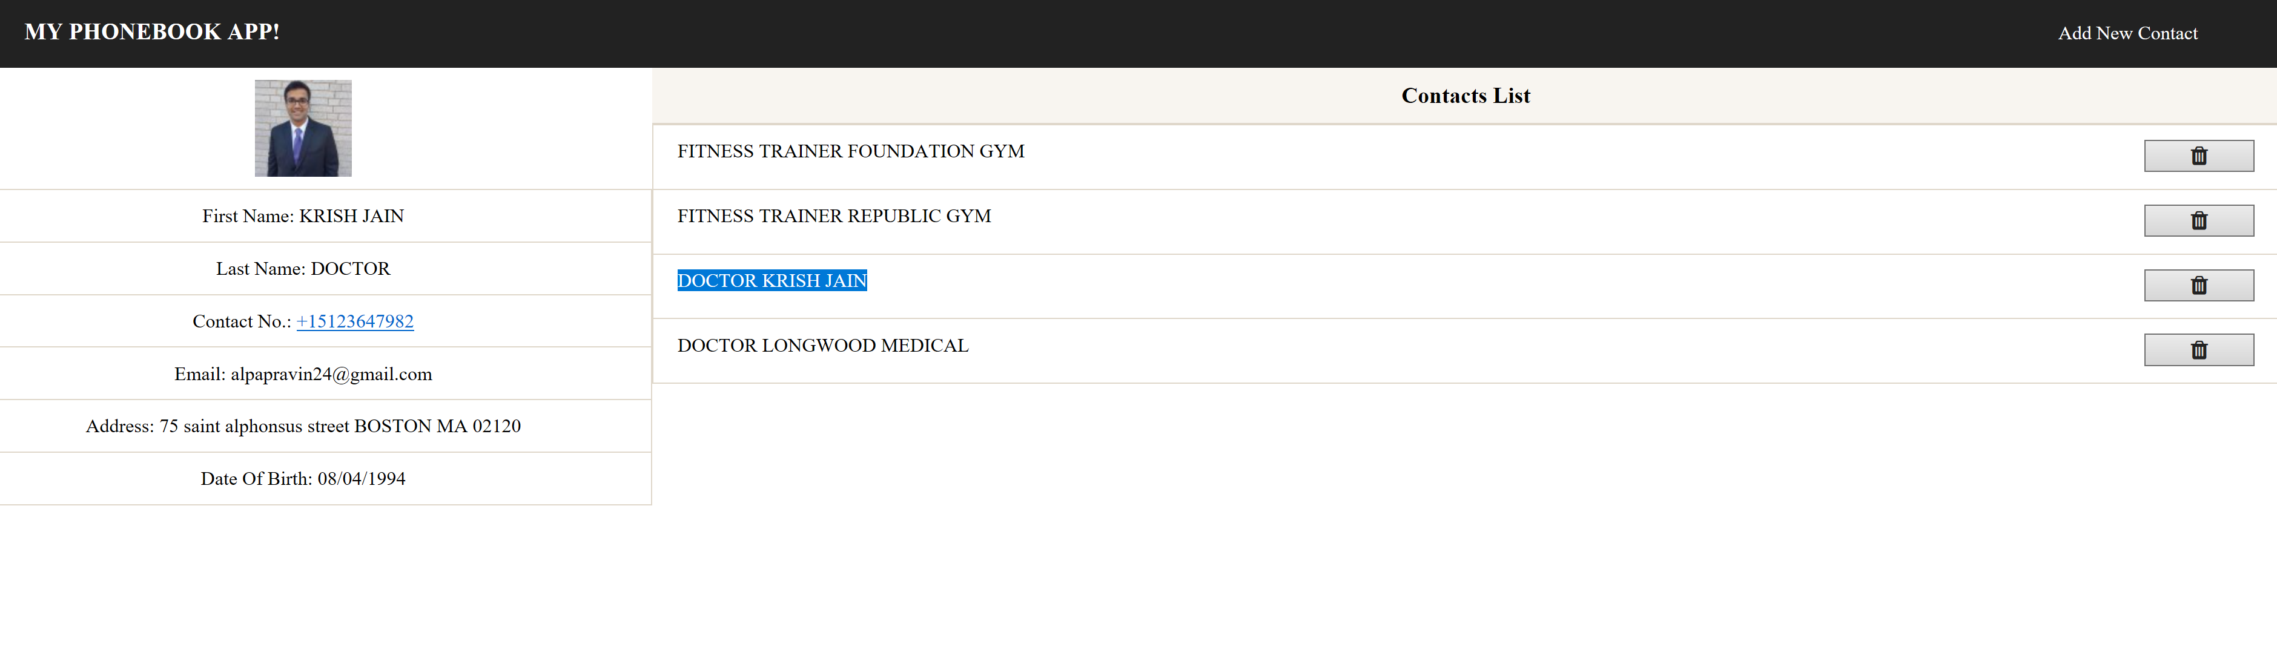

Slide 24
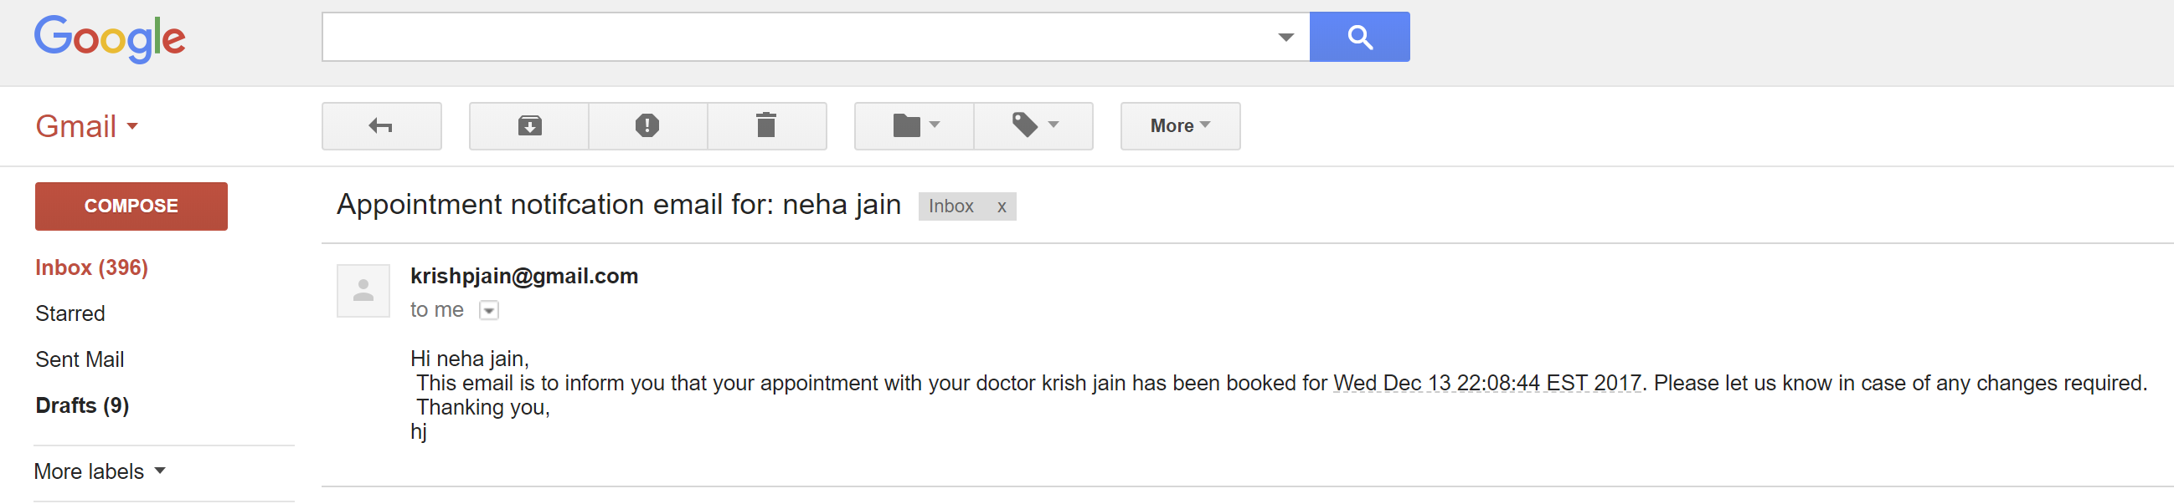

Slide 25
THANK YOU!!!!!!!

